Slide 1
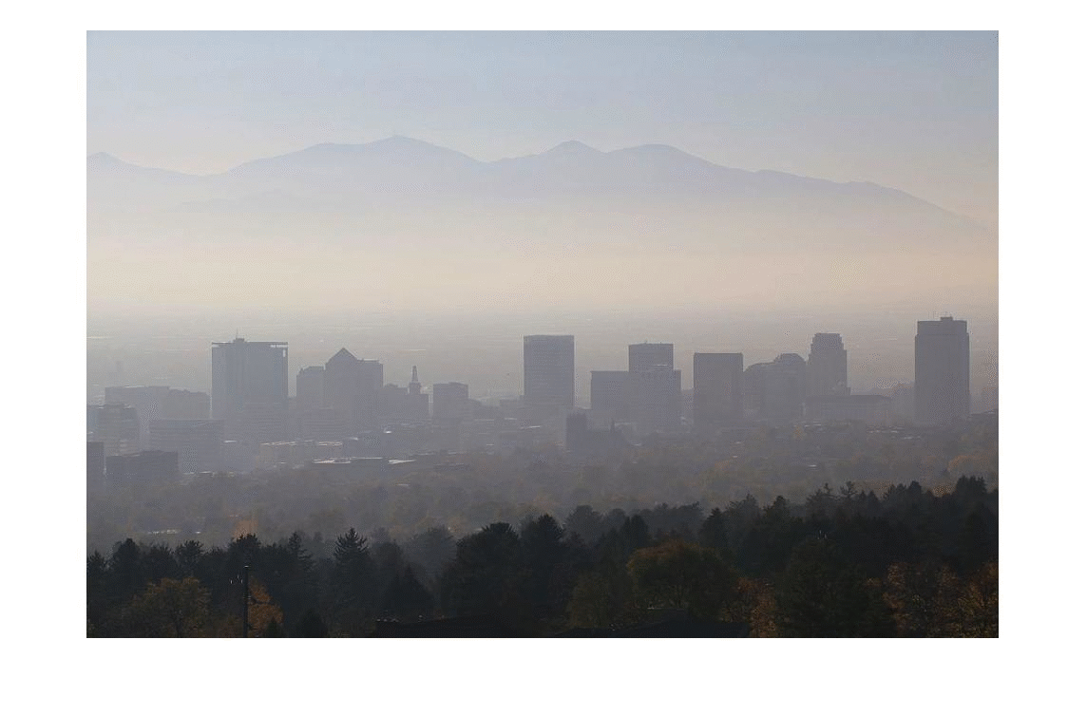


Takashi Matsuzawa Kevin Lin Xuetong Du

Slide 2
Motivation
Method
A. Retrieve dark channel information
B. Depth estimation
C. Recover scene
Problems
Possible solution
Result
Notes:
There will be 5 parts for our presentation. First, we will be talking about the motivation and why we are interested in such a topic. Next we’ll be going in details about the methods we used to retrieve the dark channel information, and using that information to estimate depth, and finally restore the image. The third part will be the problems we encountered in the development and then how we solve it. Last but not least, we will analyze our final result.

Slide 3
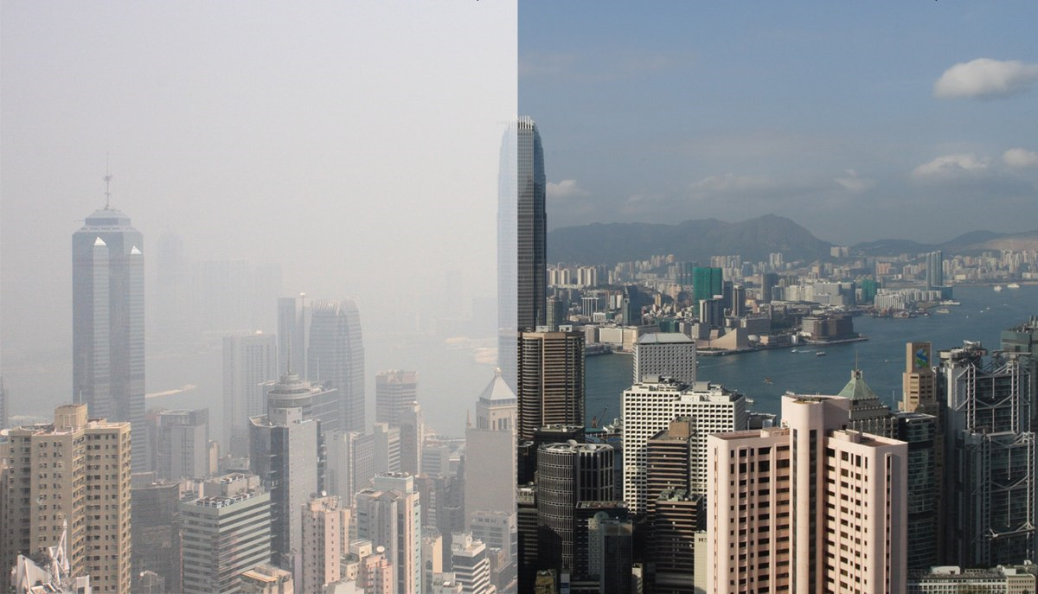
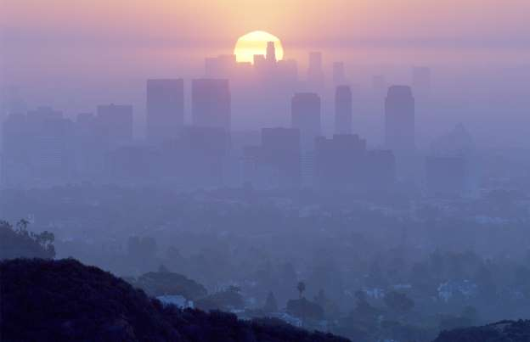
Motivation
Notes:
Haze is a significant problem in our hometown, the Eastern Asia. With image dehazing, we strive to restore the original view and make images more appealing.

Slide 4
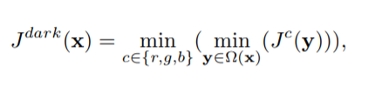
Dark Pixels

Slide 5
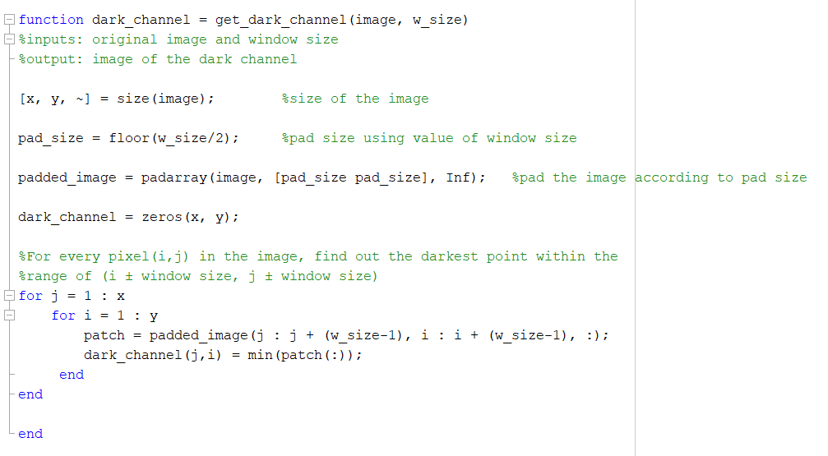
Code for Dark channel information
between green and orange.
Notes:
Now I’m going to talk about the code we used to achieve our goal. First of all, we want to retrieve the information about the dark channel. If you guys wondering what exactly the dark channel is, it is a group of the dark pixels where

Slide 6
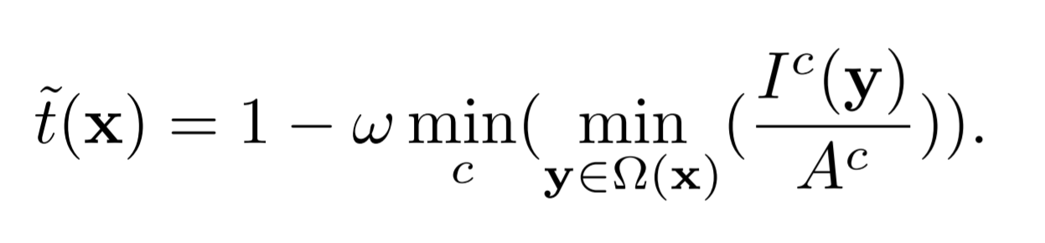
Depth/Transmission Estimation

Slide 7
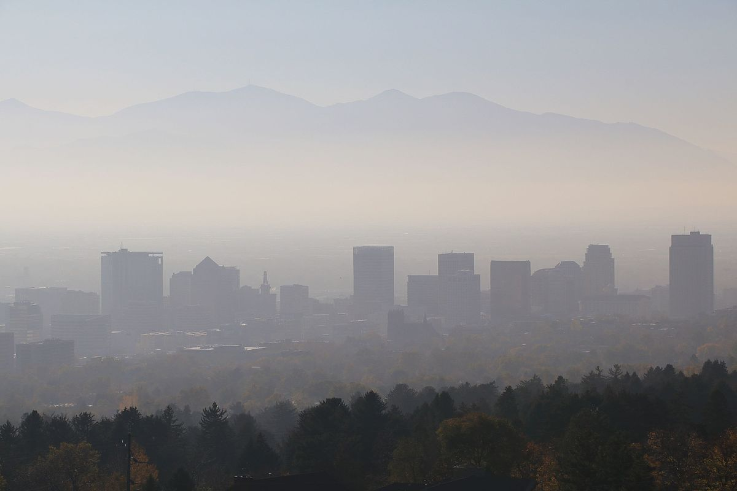
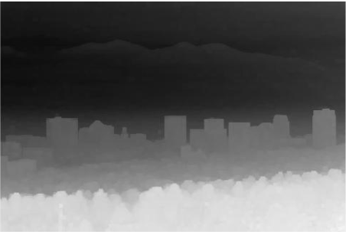
Original Image
Depth estimation image

Slide 8
Problem
Random dark pixels in the image could create significant noise in the depth estimation image since the padded method greatly intensifies its presence.

Slide 10
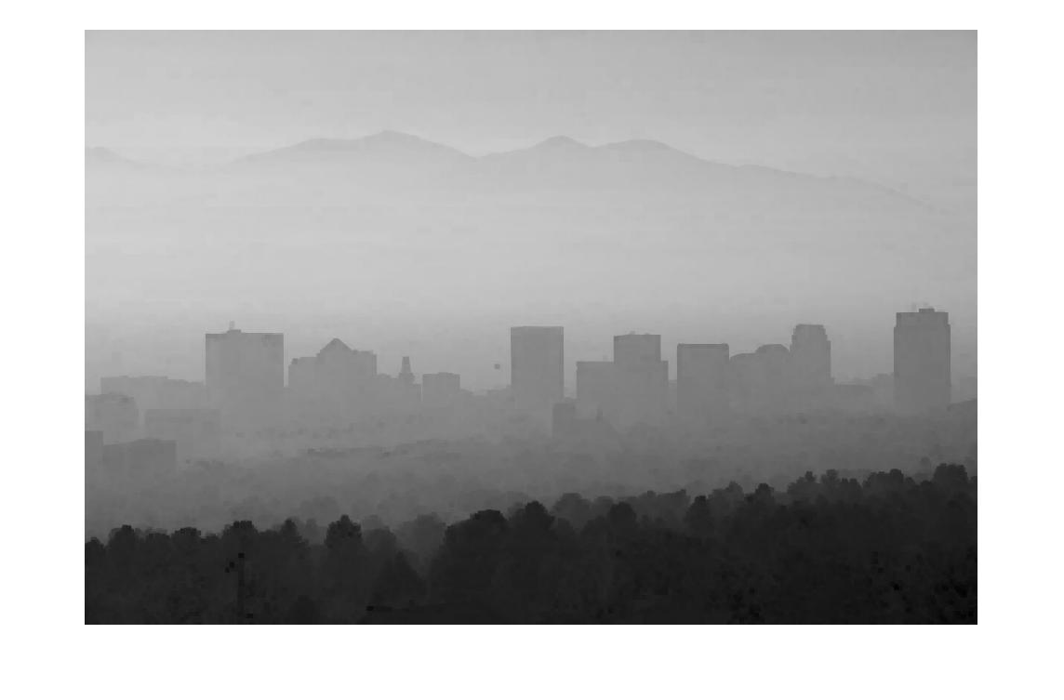
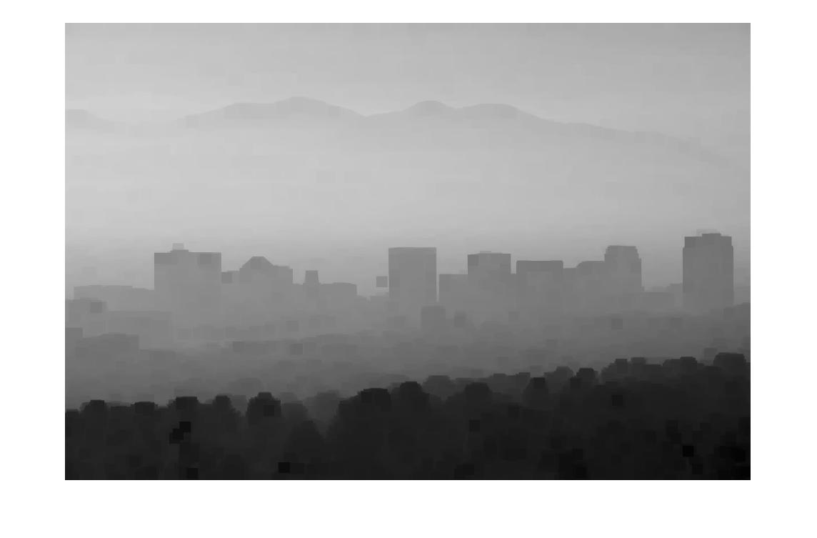
padded size = 1
padded size = 10

Slide 11
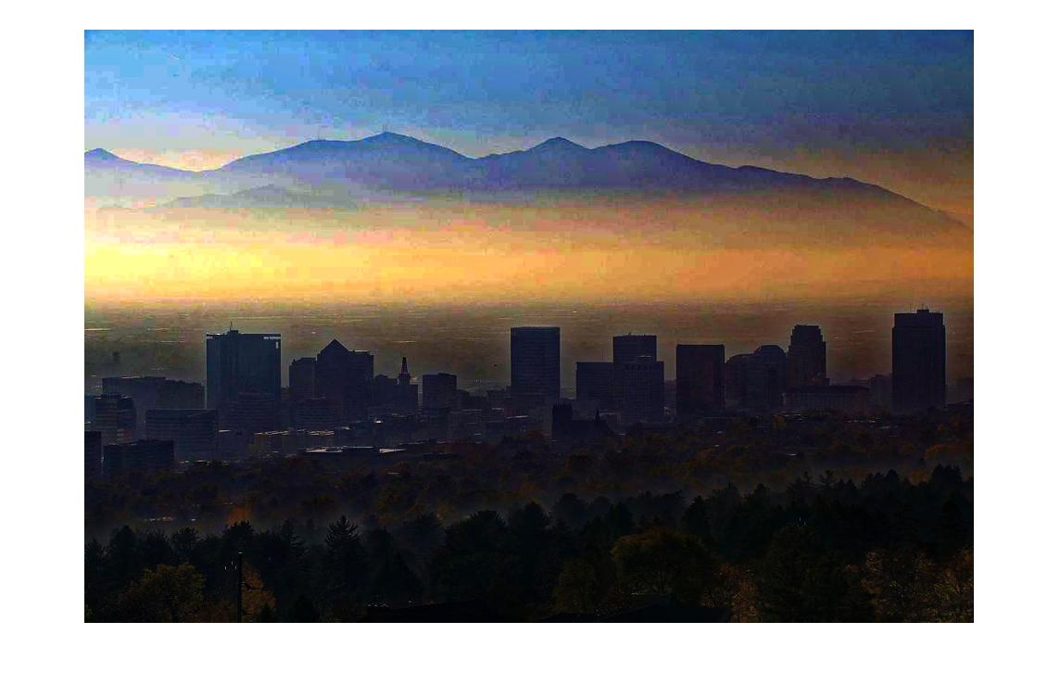

Guided Filter (box filter)
Result with filter
Result without filter

Slide 12
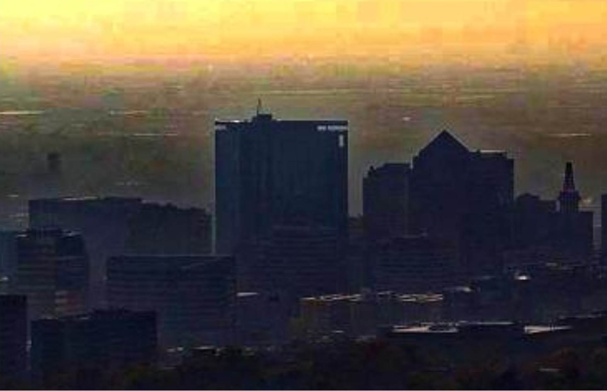
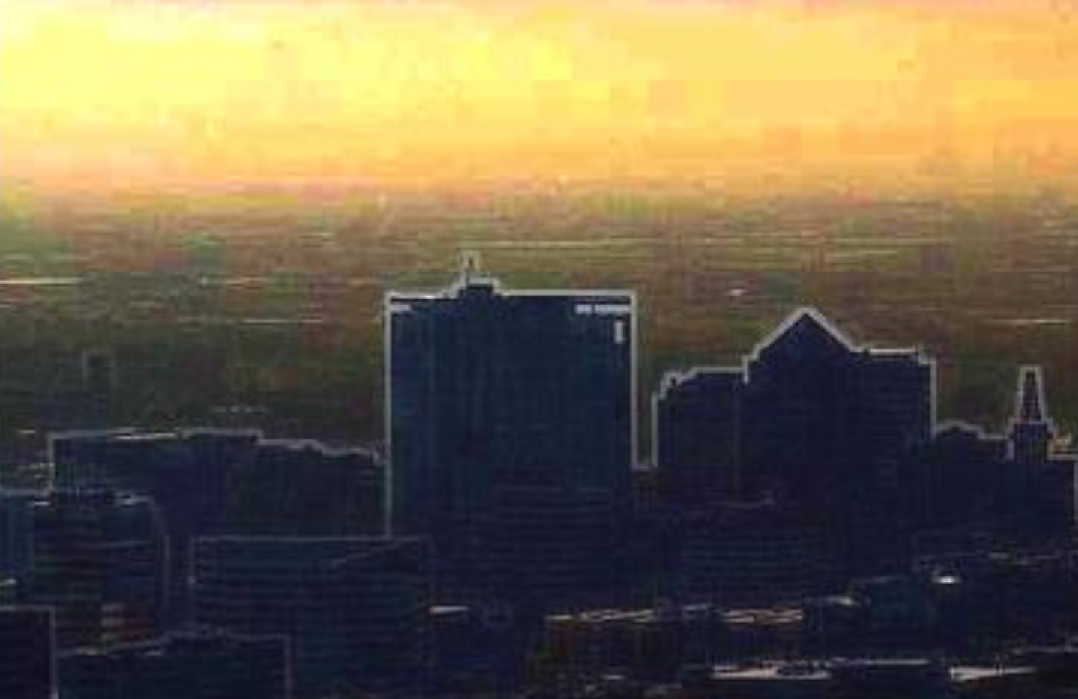
Result with filter
Result without filter

Slide 13
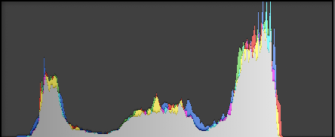
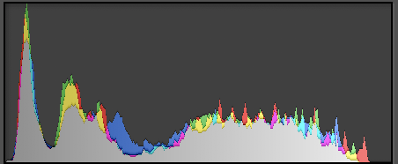
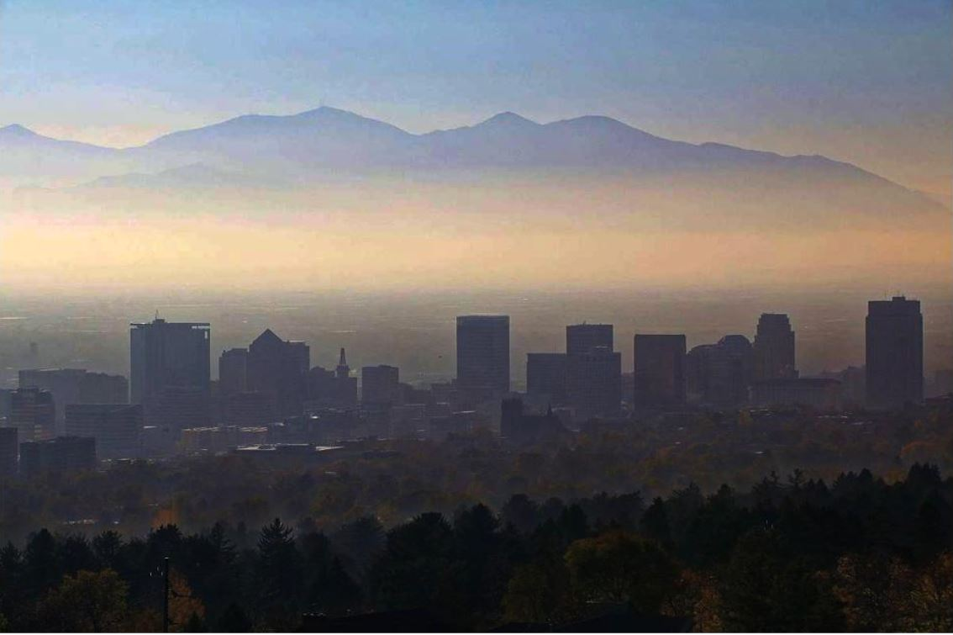
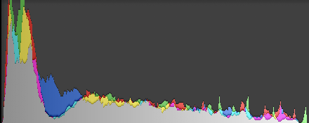
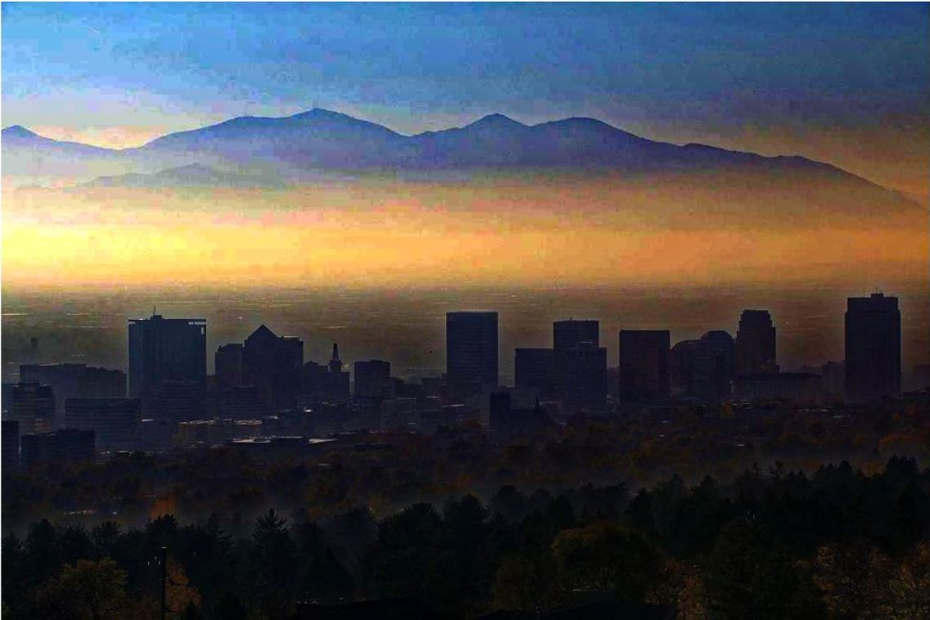
ω = 0
ω = 0.6
ω = 0.95
Notes:
The 3 pairs of images are 3 different intensities of the result with their respective histogram. Nothe that the 3 peaks in the original image represents 3 different levels of depth

Slide 14
ω used: 0.2, 0.4, 0.6, 0.8, 0.95
Notes:
Depth estimation makes the nearer area changes subtly while the further area changes dramatically.

Slide 15
CREDITS
Image used from: https://www.smithsonianmag.com/smart-news/these-are-worst-cities-air-pollution-180968871/
Single Image Haze Removal Using Dark Channel Prior. http://kaiminghe.com/publications/cvpr09.pdf

